Slide 1
A quick introduction to two open multi-omic datasets BrainHack 2017, Toronto
Leon French
Computational Neurobiology lab
Campbell Family Mental Health Research Institute
Centre for Addiction and Mental Health

Slide 2
Hackathon Theme:
Advances and Challenges in Neuroscience Data Integration (multi-centre, multimodal, & multi-species)

Slide 3
Hackathon challenges:
Data access

Slide 4
Hackathon challenges:
Data access
Integration

Slide 5
Outline
Allen Human Brain Atlas
Multi-omic: transciptome, connectome (DTI images)
Open
MyConnectome
Multi-omic: connectome, transcriptome, metabolome
Multi-center
Open
Allen Mouse Brain Atlases
Multi-omic: transcriptome, connectome
Open
Know of others? Let me know

Slide 6
Allen Human Brain Atlas
Comprehensive study of gene expression
6 human postmortem brains
3702 brain samples
58,692 measurements of gene expression
over 200 million gene expression values!
Hawrylycz, et al. (2012) An anatomically comprehensive atlas of the adult human brain transcriptome, Nature 489: 391-399

Slide 7
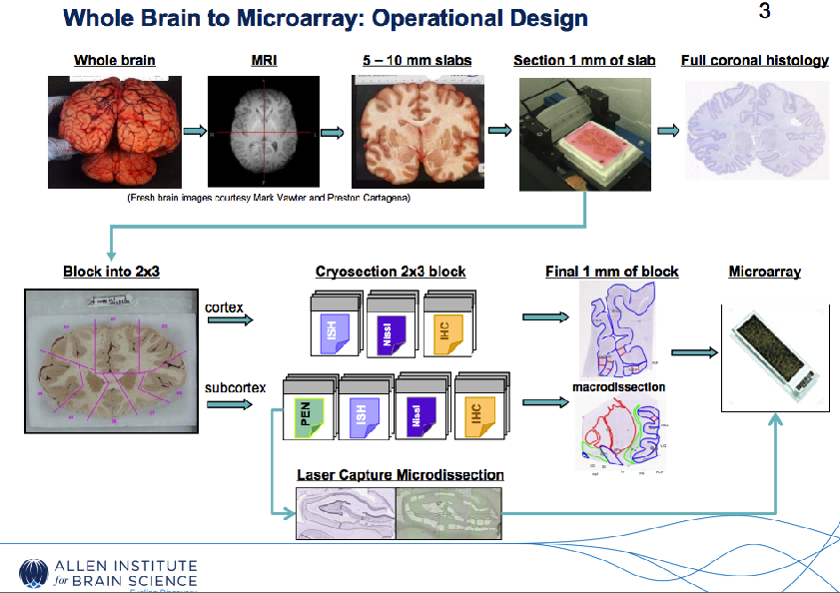
Outline
Epigenetic signals of brain plasticity
Integration of molecular data in postmortem brain
Integration of molecular and imaging data
FreeSurfer view of the cortical transcriptome
Integration for cortical regions
Cannabis receptor 1 example use case
Slide from 2012_Hackathon_Mike_Hawrylycz_Human_Microarray_Gene_Expression_Data.pdf.

Slide 8
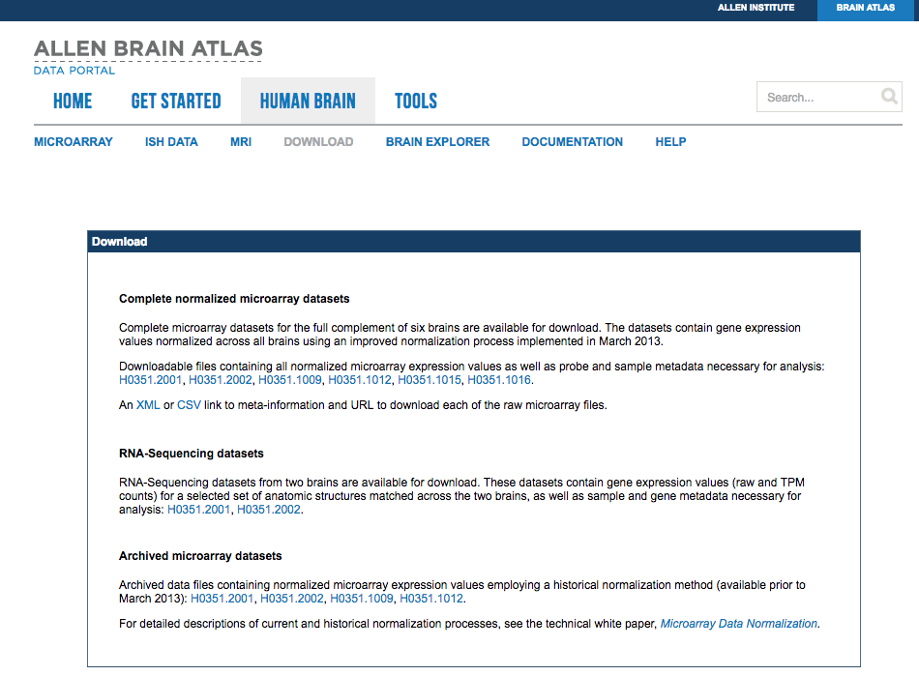

Slide 9
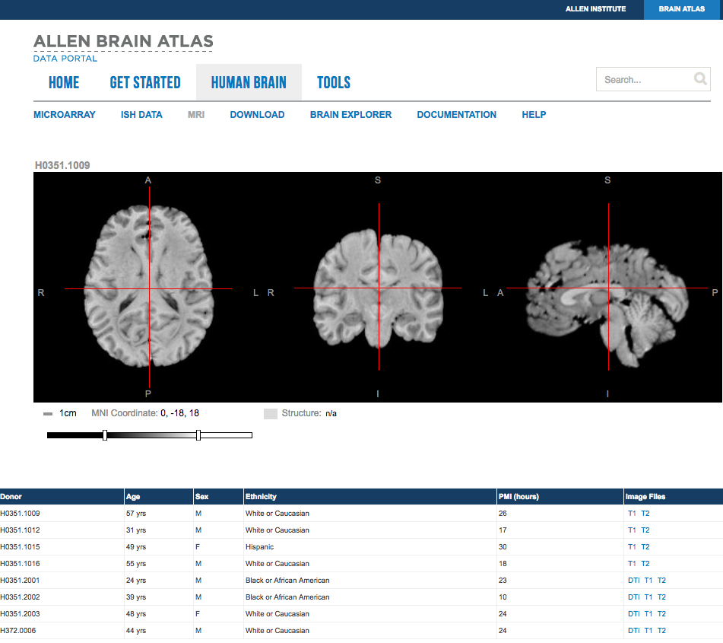

Slide 10
Integration
By genes - easiest
MNI coordinates have been annotated for the 3,702 locations
T1 and T2 MRI images for all six brains
DTI images for 2 individuals
Refined MNI Coordinates from Chris Filo Gorgolewski:
https://github.com/chrisfilo/alleninf/blob/master/alleninf/data/corrected_mni_coordinates.csv

Slide 11
Things to know
Donor brains were normal
Some MRI images obtained in cranio, others ex-cranio
Both hemispheres assayed first two brains only
The six donors vary in age, sex and ethnicity
Best used to study molecular neuroanatomy
In general, differences in gene expression:
Across regions > species > individuals

Slide 12
Open tools
Allen Institute API and website
Differential expression, single gene views
ABAEnrichment
R package for differential expression
MENGA
To compare expression of single genes with MRI based data
LinkRbrain (BrainHack 2013)
Analysis -> Gene Expression Decoding functionality in NeuroVault
http://www.brainscope.nl/brainscope -tSNE visualization
Freesurfer mapping
HBASet
Visualization of polygenic expression patterns
www.chibi.ubc.ca/~lfrench/HBAset/

Slide 13
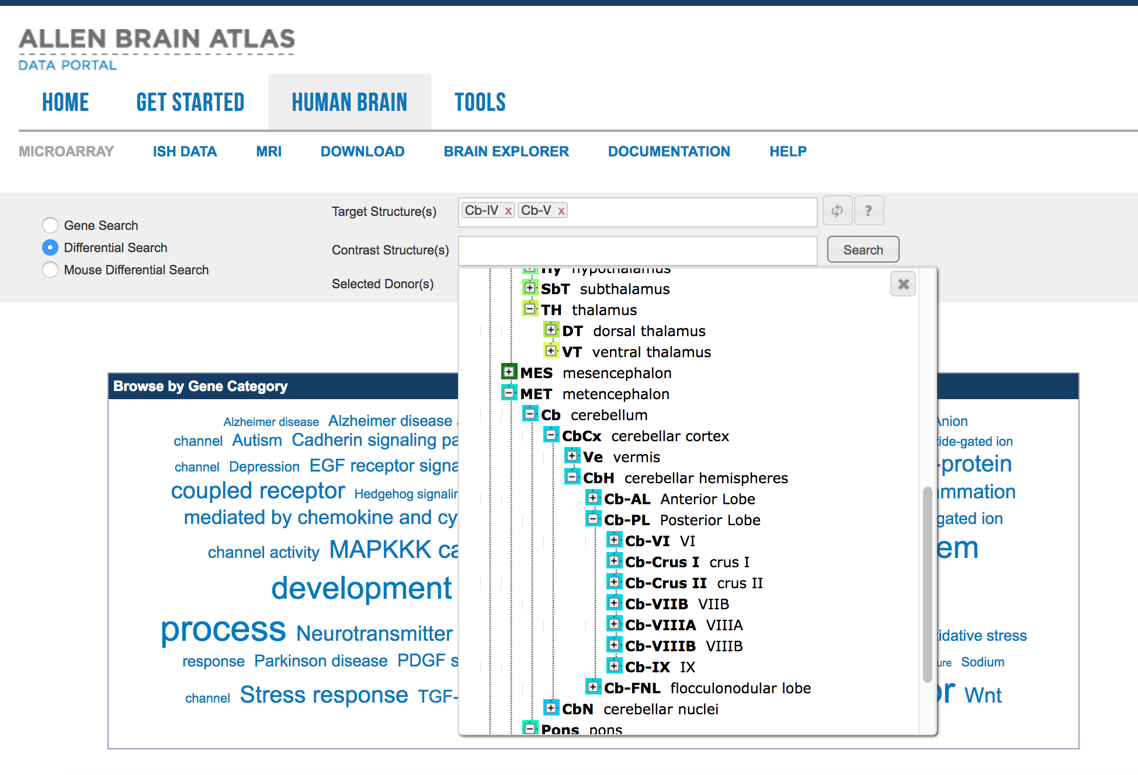

Slide 14
For a gene of interest:
What is its regional expression pattern across the FreeSurfer cortical regions?

Slide 15

Using the Allen Human Brain Atlas
Download from the website for CNR1 provides 3 data files:
A matrix 329,478 expression values
A spreadsheet with information about the expression probes (89 rows)
A spreadsheet with information for each sample (3702 rows)
Hawrylycz, et al. (2012) An anatomically comprehensive atlas of the adult human brain transcriptome, Nature 489: 391-399
Wikipedia: Ildar
Sagdejev (Specious)

Slide 16
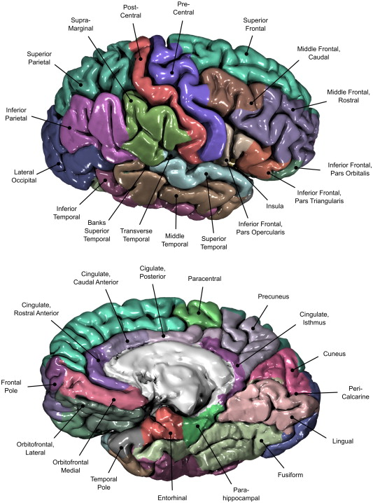
Solution: summarize the expression data into a commonly used cortical parcellation.
Image from: Cortical thickness or grey matter volume? The importance of selecting the phenotype for imaging genetics studies. Winkler, Kochunov, Blangero, Almasy, Zilles, Fox, Duggirala, Glahn. Neuroimage 2010.

Slide 17
Methods
Semi-automatically mapped the provided MNI coordinates to the FreeSurfer Desikan-Killiany atlas (34 regions per hemisphere)
For each gene, expression was averaged across:
Expression probes
Samples within a cortical region
Individual donor brains
Data available online
French, L., & Paus, T. (2015). A FreeSurfer view of the cortical transcriptome generated from the Allen Human Brain Atlas. Frontiers in Neuroscience, 9, 323.

Slide 18
Example use case
We observed group differences in cortical thickness that were associated with cannabis use
Are these differences across the cortex correlated with CNR1 expression levels?

Slide 19
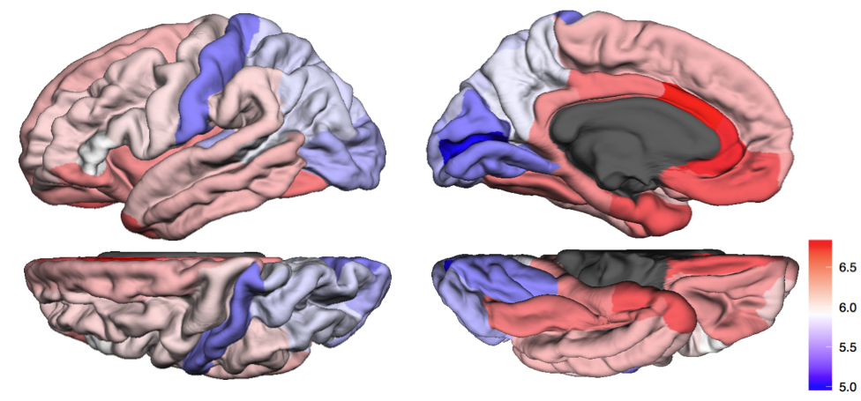
CNR1 expression shown in TkSurfer
Notes:
consistency across the six individual brains is high – 98th percentile

Slide 20
CNR1 expression across cortical regions correlates with inter-regional differences associated with cannabis use
R = -0.66, n = 34, p < 0.00005
French, L., Gray, C., Leonard, G., … Paus, T. (2015). Early Cannabis Use, Polygenic Risk Score for Schizophrenia and Brain Maturation in Adolescence. JAMA Psychiatry, 72(10), 1002-11.
Group differences in regional cortical thickness between those who never and ever used cannabis show a gradient as a function of the regional differences in CNR1 expression [1].
Notes:
Group differences in regional cortical thickness between those who never and ever used cannabis show a gradient as a function of the regional differences in CNR1 expression.

Slide 21
For a set of genes of interest:
What is its regional expression pattern?

Slide 22
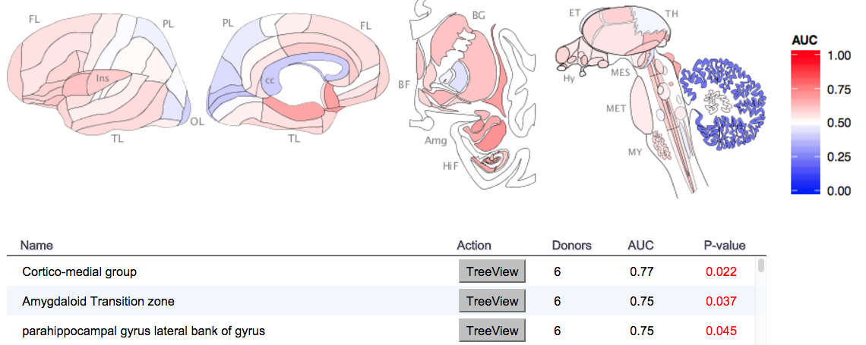
Citalopram or escitalopram responders vs nonresponders -10 genes
* Corrected for 236 regions tested
www.chibi.ubc.ca/~lfrench/HBAset/

Slide 24
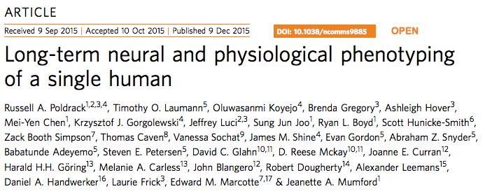
MyConnectome

Slide 25
MyConnectome
Single subject: Dr. Russel Poldrack
Brain scans twice a week for 18 months
Focused on fMRI data
Key condition: coffee + breakfast
Multi-center (two)
Transcriptomic and metabolomic data
https://github.com/poldrack/myconnectome/
https://github.com/poldrack/myconnectome-vm/

Slide 26
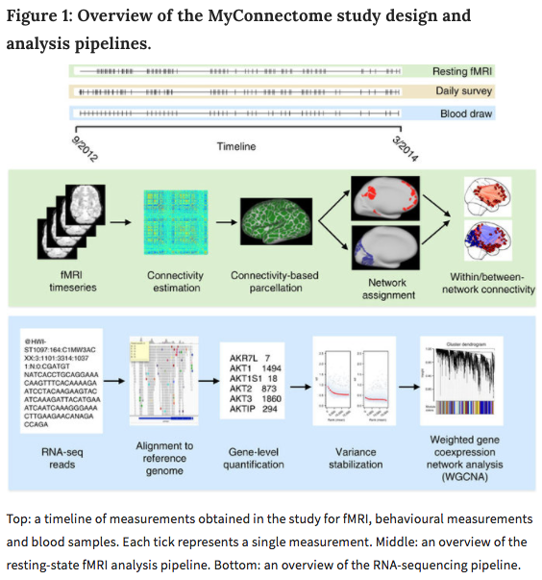
Long-term neural and physiological phenotyping of a single human. Poldrack et al. Nat Commun. 2015 Dec 9;6:8885. doi: 10.1038/ncomms9885.

Slide 27
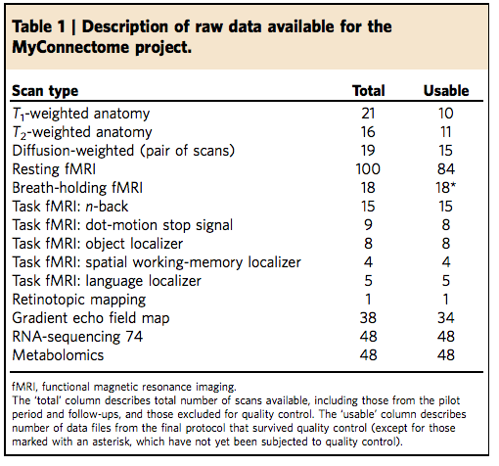
+ many other variables like sleep and surveys
Long-term neural and physiological phenotyping of a single human. Poldrack et al. Nat Commun. 2015 Dec 9;6:8885. doi: 10.1038/ncomms9885.

Slide 28
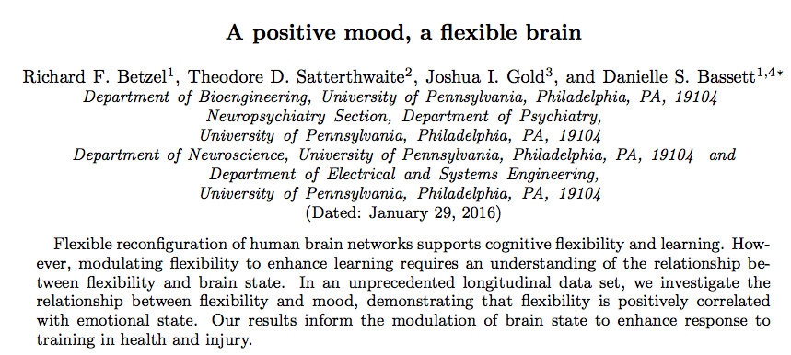

Slide 29
Fully Reproducible
Analysis pipelines provided as a virtual machine
Motivated by a linux specific bug in a R library
Takes a few hours to run
I was able to get it running on Mac OSX
Just ask me for copy of the pipeline results
One analysis didn’t complete – looking into it

Slide 30
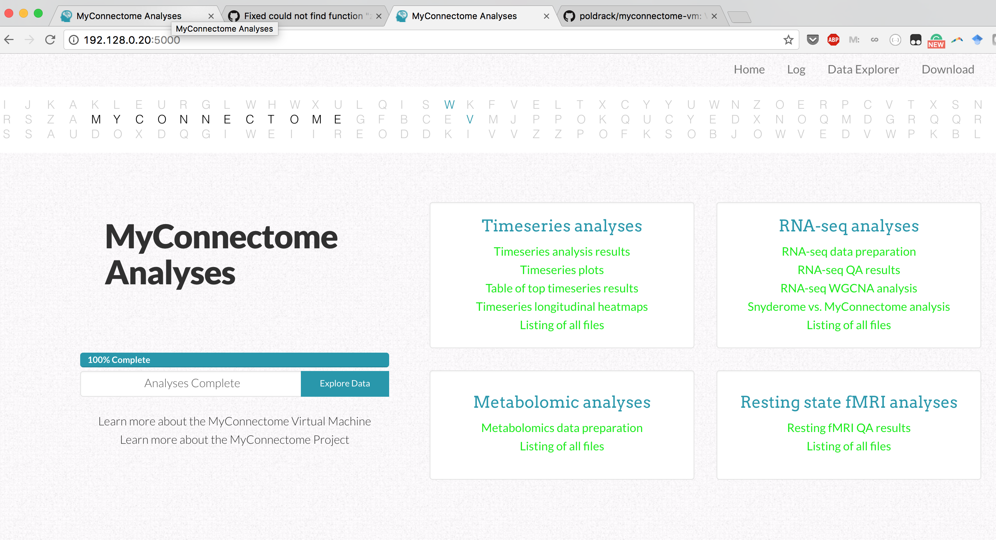

Slide 32
Multi-centre, Multimodal & Multi-species
Bonus dataset: Allen Mouse Brain atlases
Gene expression
3d – sagittal and coronal slices
Developmental data for 2,000 genes
Normalized to standardized coordinates
Connectivity
Images of axonal projections (using viral tracers)
Registered and normalized
Cre lines used to focus on specific neuronal populations

Slide 33
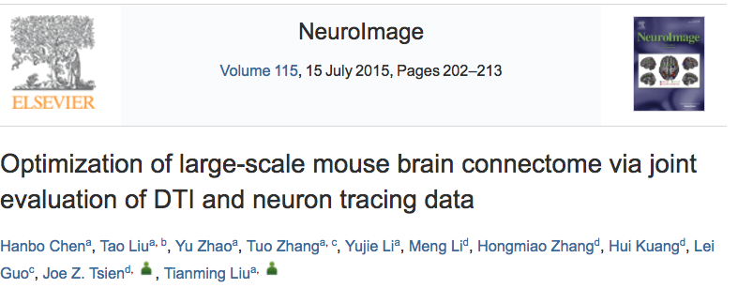
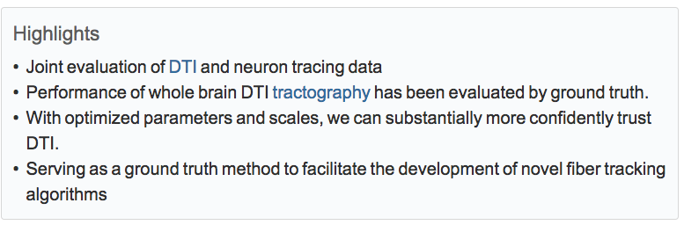

Slide 34
Allen Mouse Brain tools
Allen API and website
http://www.brain-map.org/api/index.html
Allen Atlas Brain toolbox (Matlab)
http://www.brainarchitecture.org/allen-atlas-brain-toolbox
I can share normalized gene expression images (~30gb)
Excross
For visualization of polygenic signal
Allen Brain Atlas hackathon
excross.chibi.ubc.ca

Slide 35
For a set of genes of interest:
What is its regional expression pattern?

Slide 36
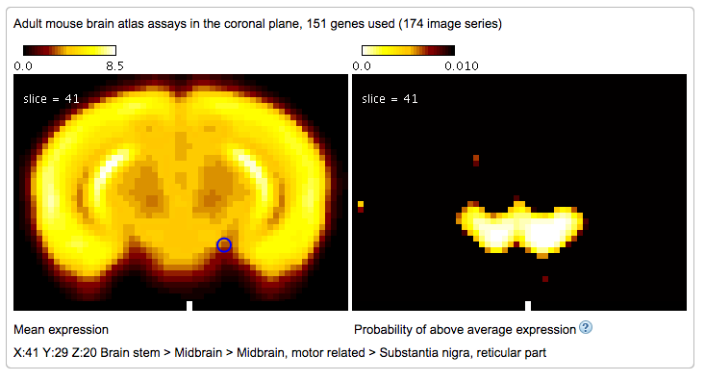
http://excross.chibi.ubc.ca Parkinson’s associated genes as input

Slide 37
Summary
Two human multi-omic datasets are online and ready to be studied
Code is available to parse the vast transcriptomic, metabolomic, and connectomic data
The Allen Mouse Brain Atlases allow cross-species comparisons

Slide 38
Thanks for sharing
Allen Institute for Brain Science
Dr. Russel Poldrack and co-authors
Thanks to the BrainHack organizers
Dr. Tomas Paus and lab at Baycrest
Dr. Paul Pavlidis and lab at UBC

